Slide 1
Introduction to Tableau
Part 10
Notes:
Welcome back to Data Society! We have a great class ahead of us today.

Slide 2
Module completion checklist
Objective | Complete
Implement string calculations on a given dataset
Implement date calculations on a given dataset
Implement type calculations on a given dataset
Implement logic calculations on given dataset

Slide 3
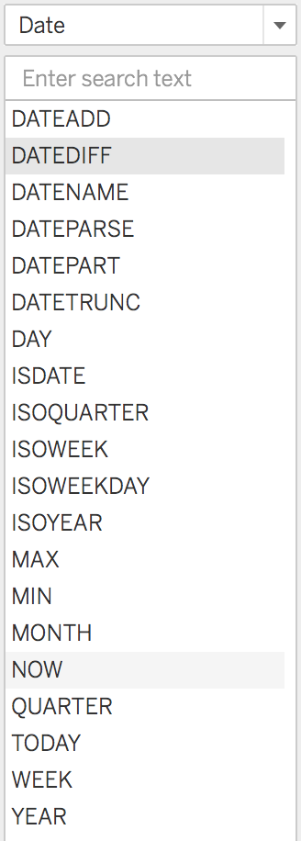
Date functions
Date functions allow you to manipulate dates and extract certain features, like month, day, week, etc.
Notes:
The purpose of this slide is to introduce date functions.

Slide 4

Date function: DATENAME
DATENAME takes two arguments, returning a requested date_part for a given date.
DATENAME('year', #2004-04-15#) = "2004."
DATENAME('month', #2004-04-15#) = "April."
Notes:
The purpose of this slide is to introduce the DATENAME function.

Slide 5
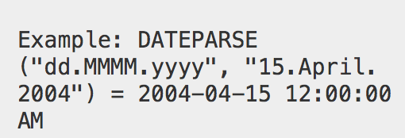
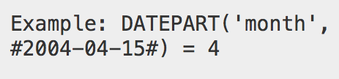
DATEPARSE and DATEPART
DATEPARSE
Allows you to control date formatting.
DATEPART
Allows you to get a piece of a date.
Both DATENAME and DATEPART can be used to return the month of a given date – so what’s the difference?
Notes:
The purpose of this slide is to introduce DATEPARSE and DATEPART functions. ASK the question at the bottom of the screen and COMMENT on student responses.
DATENAME and DATEPART can both be used to return the month of a given date. But whereas DATENAME will return a text string, DATEPART returns a numerical value. EXPLAIN why these two different possible returns are useful.

Slide 6
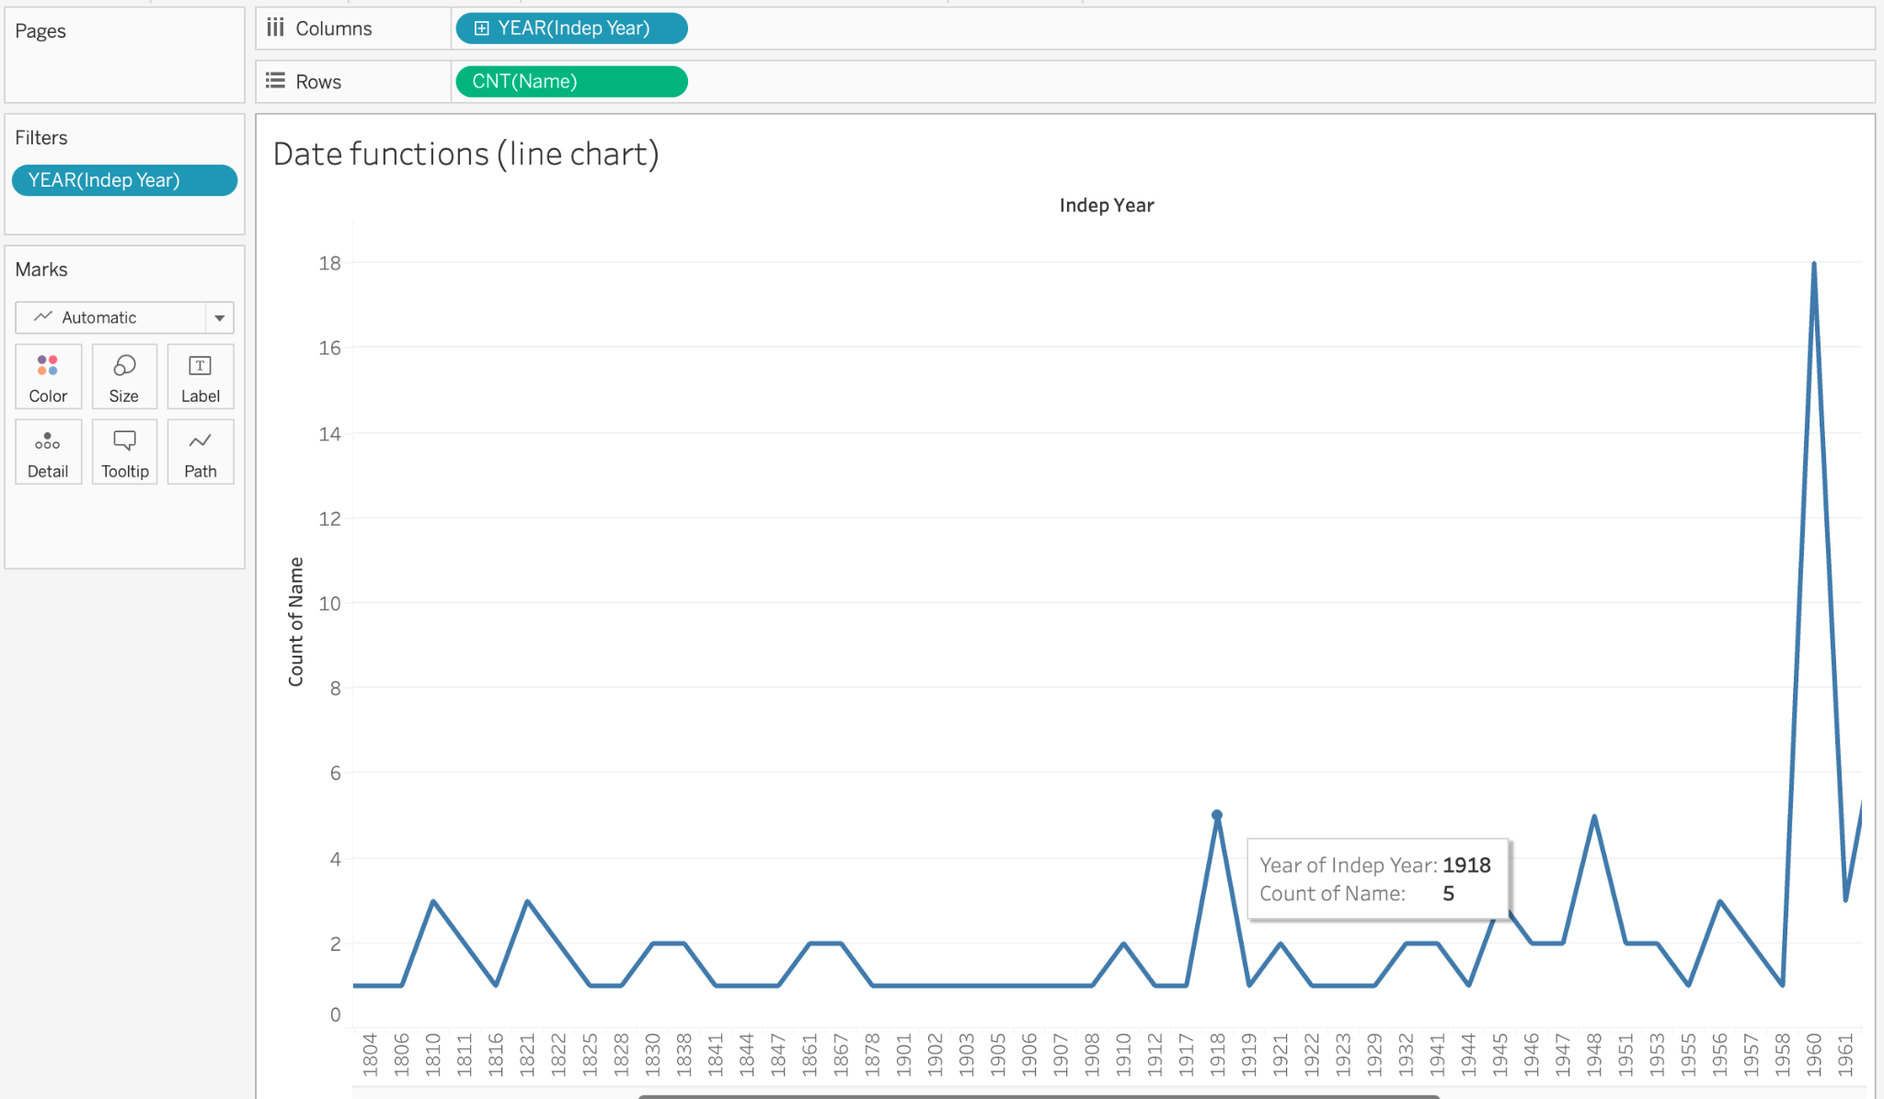
Setting up a date-related chart
To practice using these functions, let’s use the world data to plot a line chart showing the number of countries that became independent in a given year.
Notes:
The purpose of this slide is to create a visualization using the world data amenable to practicing using date functions. In this case, WALK THROUGH how to create a line chart representing the number of countries that became independent by year.

Slide 7
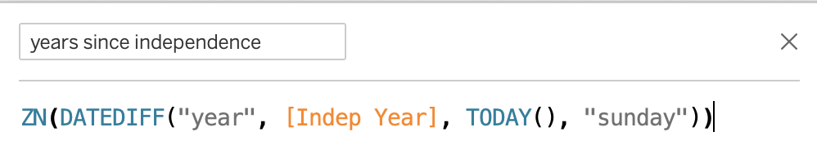
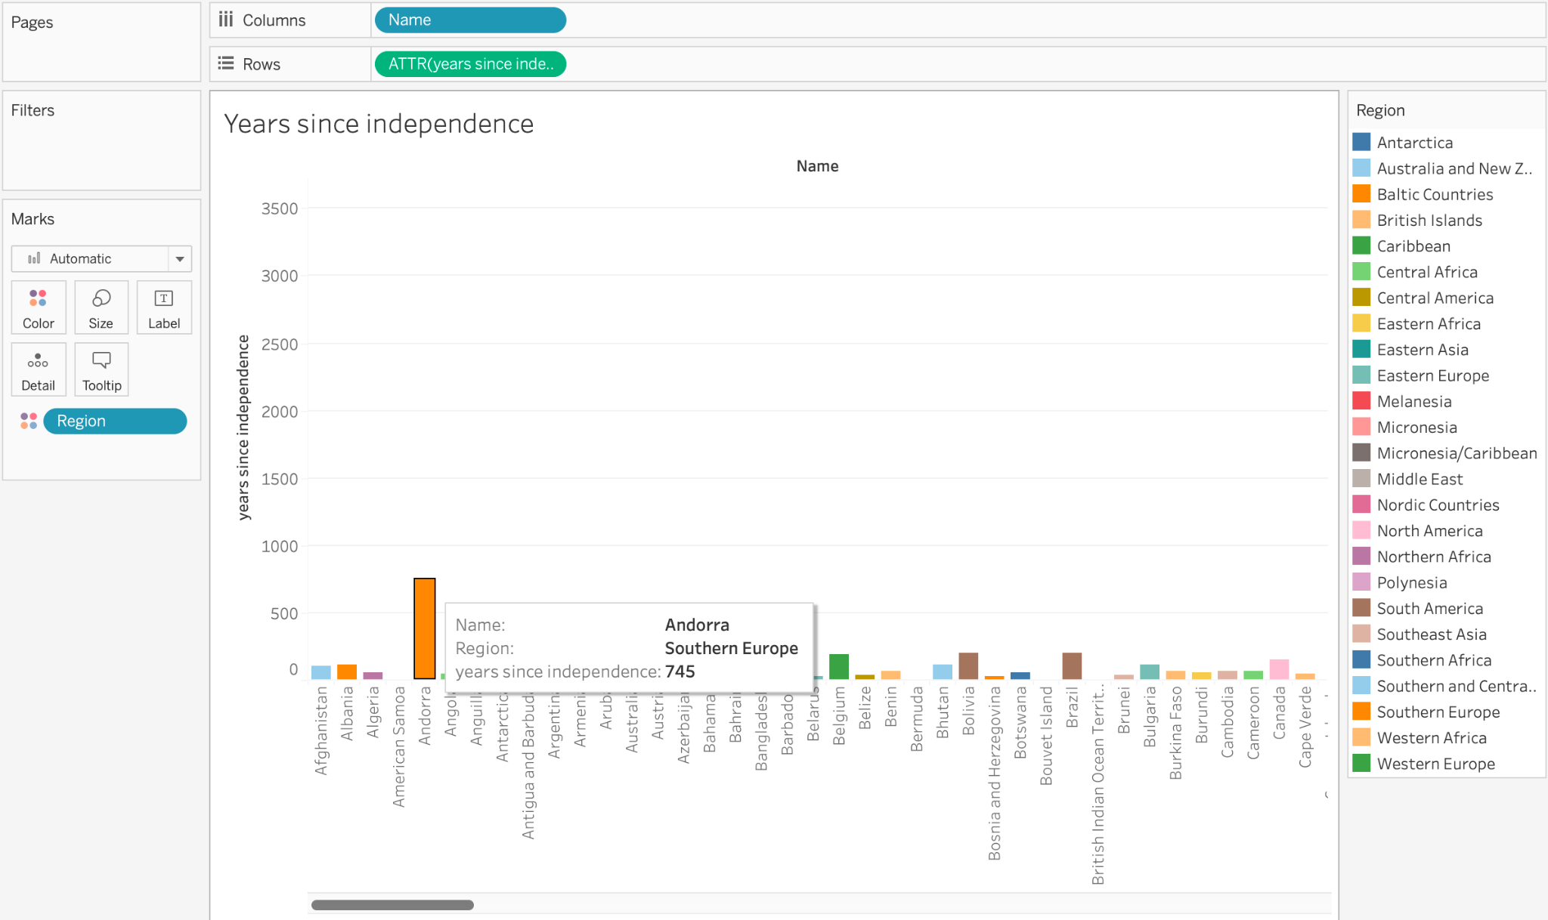
Date functions in the world dataset
Get the years since independence for a country using these functions:
TODAY
YEAR
Next, replot the independence.
Graph as a bar chart.
What does this chart tell us?
Notes:
The purpose of this slide is to demonstrate using date functions to manipulate the world dataset. WALK THROUGH the steps necessary to produce the visual on the slide.

Slide 8
Module completion checklist
Objective | Complete
Implement string calculations on a given dataset
Implement date calculations on a given dataset
Implement type calculations on a given dataset
Implement logic calculations on given dataset

Slide 9
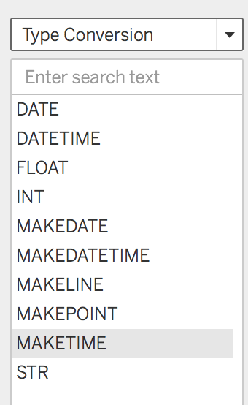
Type functions
Type functions allow you to convert fields from one data type to another.
For example, you can convert numbers to strings so that Tableau does not try to aggregate them.
Notes:
The purpose of this slide is to introduce and define type functions.

Slide 10
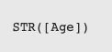
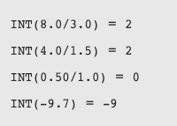
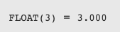
Typecasting functions
Typecasting functions are type functions that convert one data type to another.
STR
INT
FLOAT
Notes:
The purpose of this slide is to introduce and define three typecasting functions in Tableau: STR, INT, and FLOAT. EXPLAIN when you might want to use each function.

Slide 11
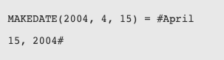
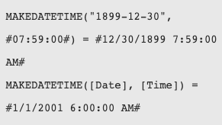
MAKE functions
MAKE functions return date and time values given certain arguments.
MAKEDATE returns a time value constructed from the specified year, month, and date.
MAKEDATETIME returns a datetime that combines a date and a time.
The date can be a date, datetime, or a string type.
The time must be a datetime.
Notes:
The purpose of this slide is to introduce the MAKEDATE and MAKEDATETIME functions. EXPLAIN why the arguments must be in a certain type in order to be valid. EXPLAIN a use for these kinds of outputs.

Slide 12
Module completion checklist
Objective | Complete
Implement string calculations on a given dataset
Implement date calculations on a given dataset
Implement type calculations on a given dataset
Implement logic calculations on given dataset

Slide 13
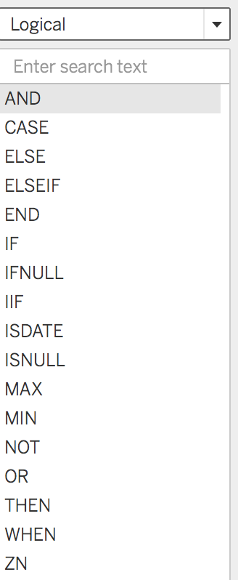
Logical functions
Logical functions allow you to determine if a certain condition is true or false (boolean logic).
Tableau offers all the basic logical functions for managing control flow and performing Boolean tests.
Notes:
The purpose of this slide is to introduce Tableau’s logical functions.

Slide 14
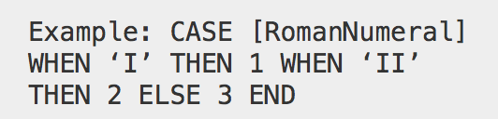
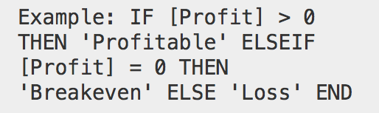
Case switching and conditionals
Case switch functions :
CASE , WHEN, THEN, ELSE , END
IF, ELSE conditionals:
IF , THEN, ELSEIF, THEN, END
https://onlinehelp.tableau.com/current/pro/desktop/en-us/functions_functions_logical.htm
Notes:
The purpose of this slide is to introduce two classes of logical function: case switching functions and IF / ELSE conditional functions. EXPLAIN the use of several of the specialized functions in context (i.e. how to combine WHEN, IF, THEN, ELSE, ELSEIF, and END into a control flow).

Slide 15
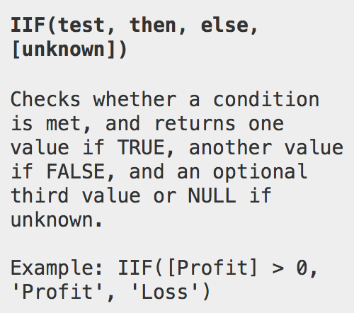
IIF test
IIF checks whether a condition is met, and then returns:
One value if TRUE.
Another value if FALSE.
An optional third value or NULL if unknown.
Notes:
The purpose of this slide is to introduce the IIF function. EXPLAIN the syntax and how to interpret the returned values.

Slide 16
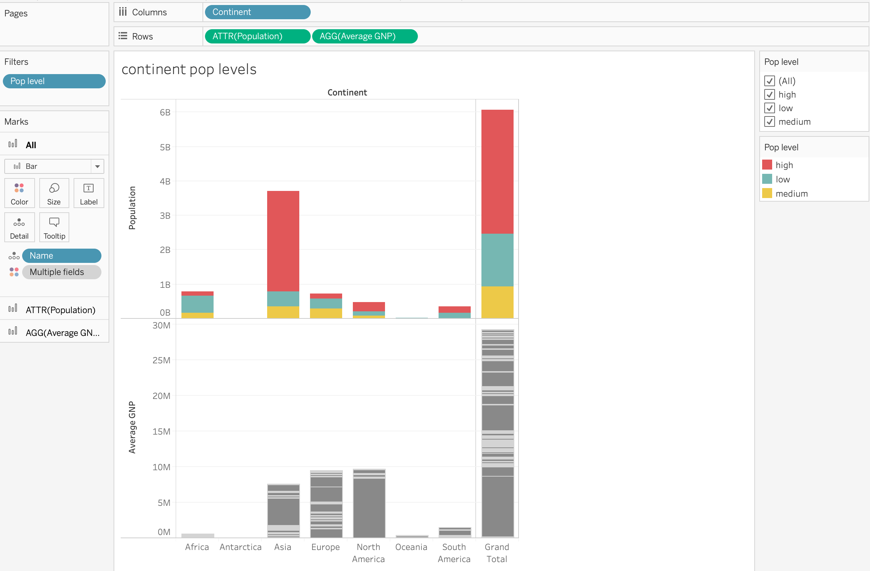
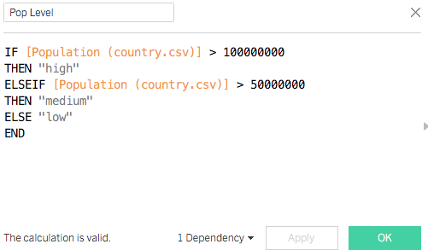
Logical functions in the world dataset
Use an IF ELSE conditional to make a “high”, “medium” and “low” population column.
Apply it to the population analysis.
Notes:
The purpose of this slide is to apply logical functions to the world dataset. WALK THROUGH how to perform the sorting on the slide.

Slide 17
Knowledge check 10

Slide 18
Exercise 10

Slide 19
Module completion checklist
Objective | Complete
Implement string calculations on a given dataset
Implement date calculations on a given dataset
Implement type calculations on a given dataset
Implement logic calculations on given dataset

Slide 20
Congratulations!
In the past few modules, we covered:
String Functions
MID
REPLACE
TRIM
Date Functions
DATENAME
DATEPARSE
DATEPART
Type Functions
STR
INT
FLOAT
MAKEDATE and MAKEDATETIME
Logical Functions
CASE
IF, ELSE, and IIF conditionals
Notes:
The purpose of this slide is to review the various topics covered in class today. It is also an opportunity to ASK if students have any outstanding questions that need to be resolved.

Slide 21
Next steps
Next few modules, we will begin mapping in Tableau!
Defining geospatial visualization
Generating coordinates
Cleaning and fixing geospatial data
Creating a final dashboard
Until then, stay excited!
Notes:
The purpose of this slide is to introduce the agenda for the next session. COMMENT briefly on each topic to set expectations and encourage prediction.

Slide 22
End of Part 10

